Slide 1
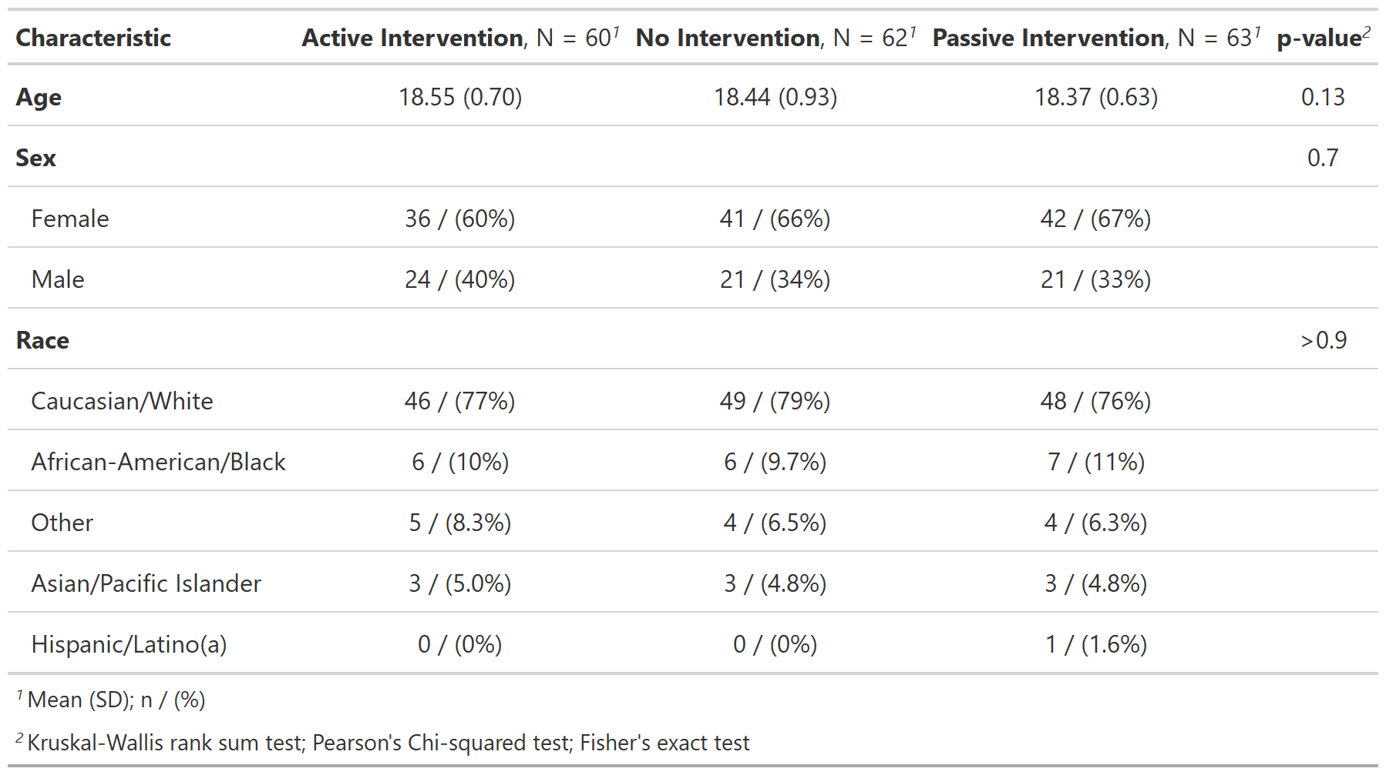
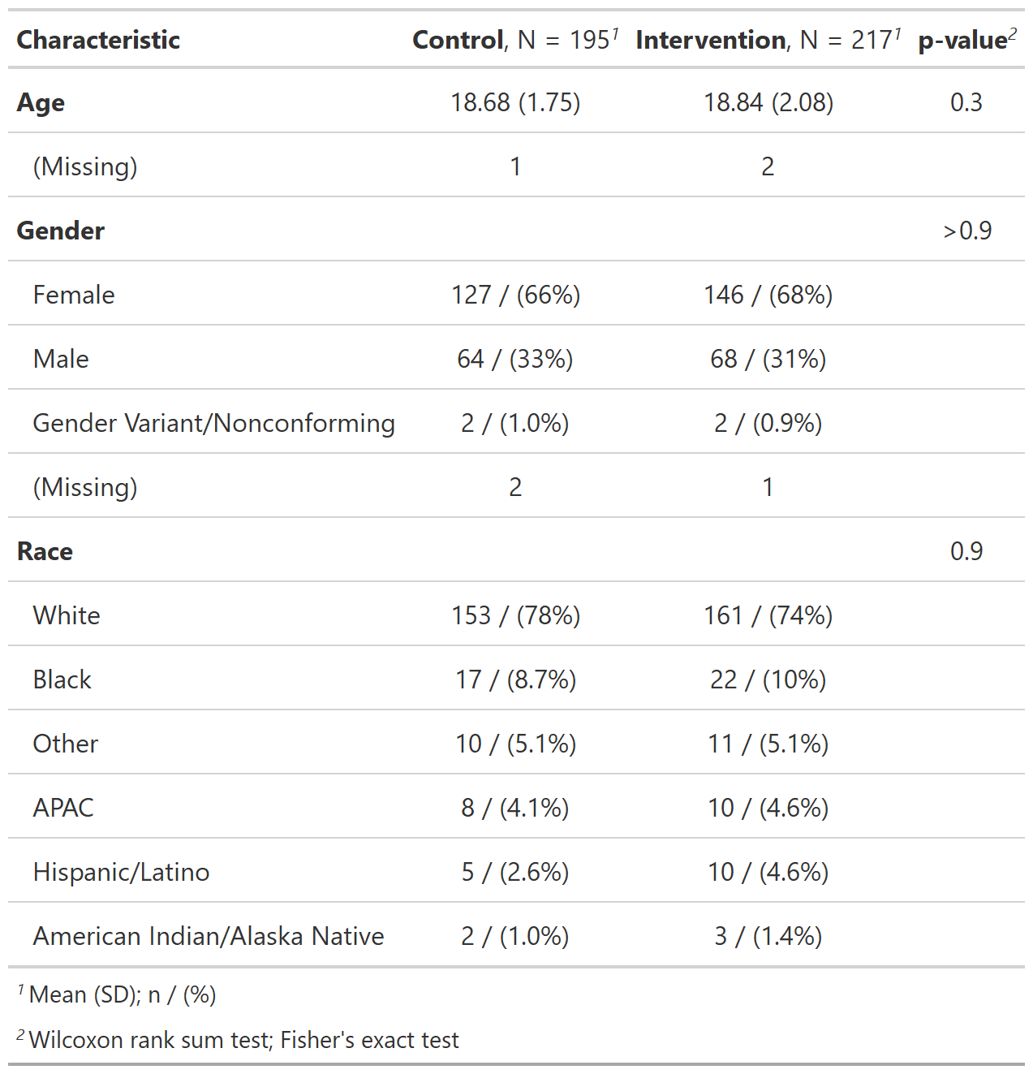

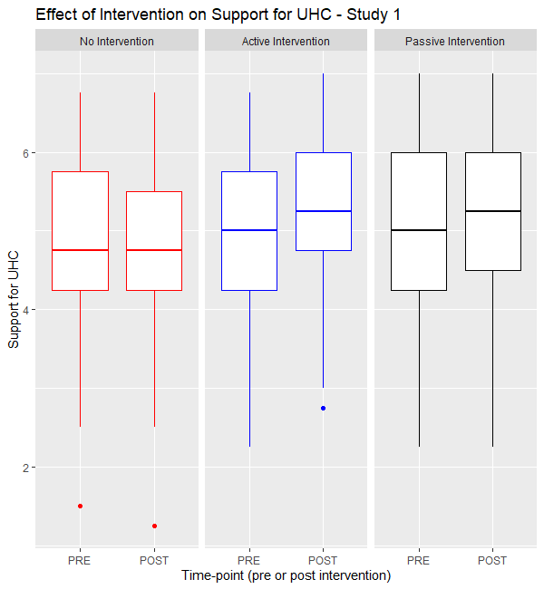
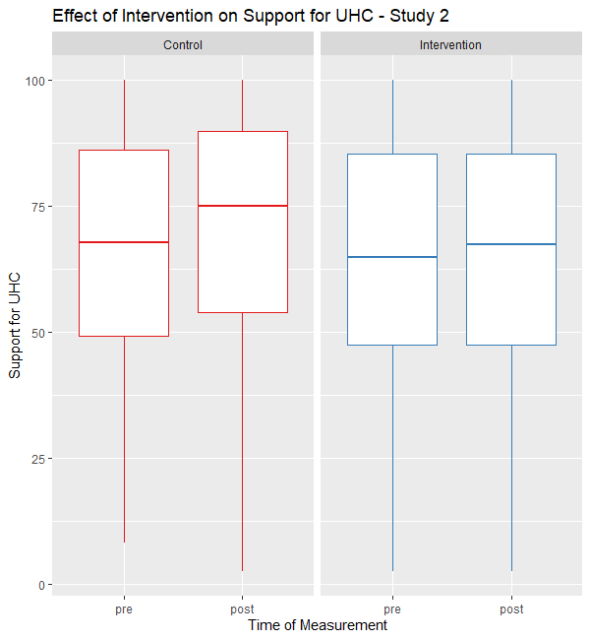
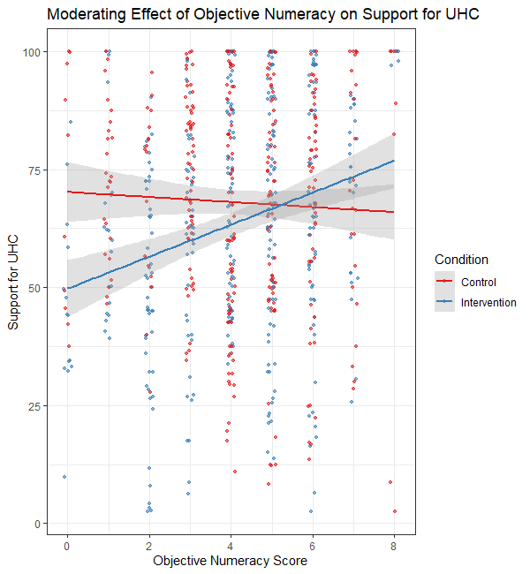
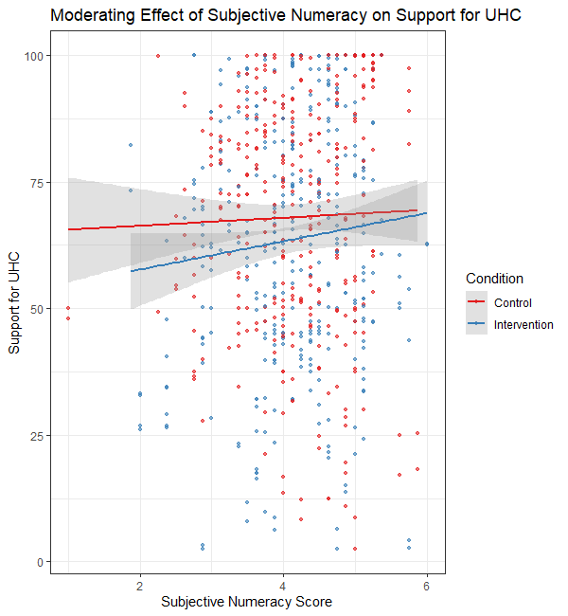
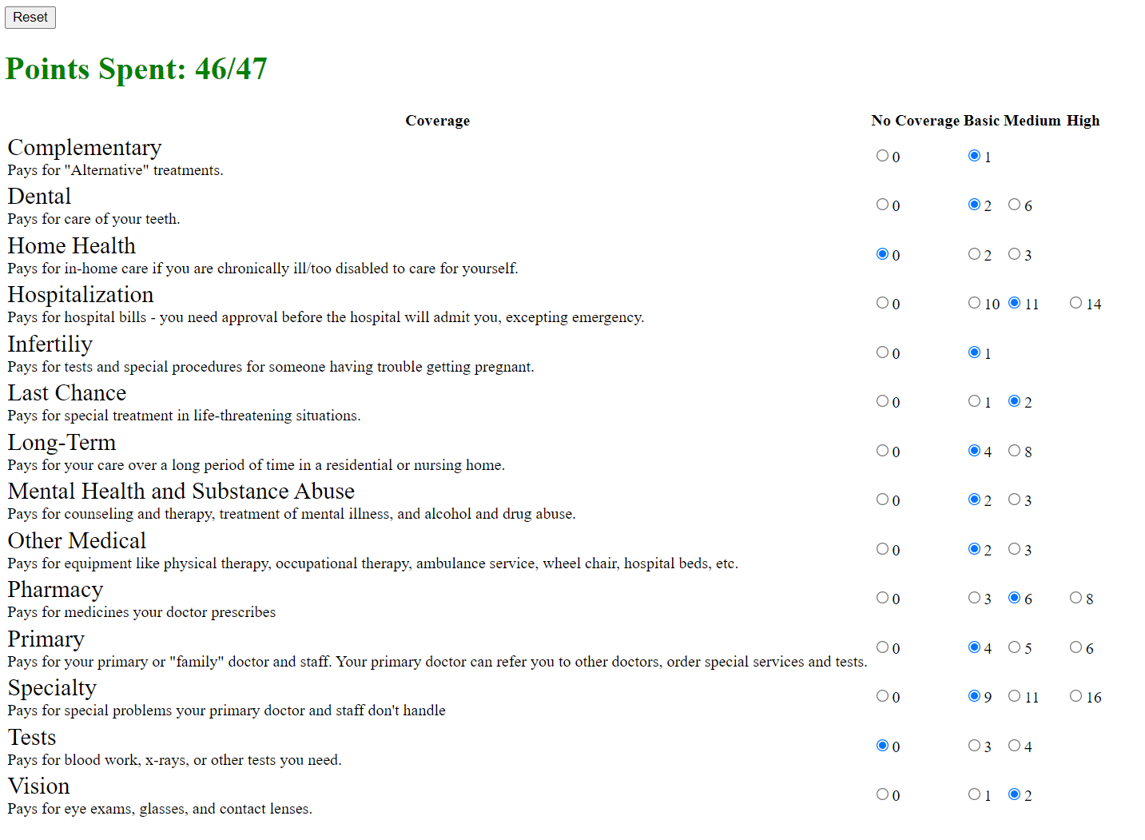
The Use of Explicit Health Benefits Packages Increases Support for Universal Health Care for People with High Objective Numeracy
Sean X. Duan BS¹, Victoria A. Shaffer PhD¹
¹University of Missouri—Columbia Department of Psychological Sciences
Background and Objectives
Universal Health Care (UHC) lacks support in the U.S.
Literature indicates that opposition to UHC is rooted in lack of comprehension and perceptions that it may be unfair.
Explicit Health Benefits packages (HBPs) may improve support for UHC by outlining the cost and scope of care, directly addressing these concerns.
To test this, we compared support for UHC after an HBP intervention, uninformative control, or ‘standard’ UHC messaging
Results
Figure 2. Demographics for Study 1 (left) and Study 2 (right).
Methods
Study 1 (N=189) – randomly assigned to build an HBP, assess a provided HBP, or an uninformative control
Study 2 (N=412) – randomly assigned to either build an HBP or read informational pamphlets about UHC; see Figure 3.
HBPs were built or provided using the “Choosing Healthplans All Together” (CHAT) simulation exercise
This consists of allocating a limited set of resources to benefit types (e.g. dental) and choosing scope of coverage (basic-to-high); see Figure 1.
For each condition in both studies, participants:
Rated support for UHC (0-100) pre/post intervention
Provided demographic information (age, sex, race, etc.)
For Study 2, participants also:
Rated comprehension of UHC (0-100) pre/post
Rated perceived equality of UHC (0-100) pre/post
Completed objective (Rasch Numeracy Scale) and subjective (Subjective Numeracy Scale) measures of numeracy.
Figure 3. Example infographic provided as ‘standard’ UHC messaging in Study 2
Discussion
In Study 1, both HBP interventions improved support for UHC compared to the control
In Study 2, there was no direct effect of intervention on support for UHC.
However, there was a significant interaction between intervention and objective numeracy
Greater objective numeracy predicted increased support for UHC in the intervention versus the control.
Support for UHC was mediated by perceived equity, but not comprehensibility
E.g. Increase in UHC support in control condition was partly mediated by increased perceived equity
Conversely, lack of increase in UHC support in the intervention was due to lack of improved perceived equity
Selected References?
Glassman, Amanda, et al., (2016) Health Systems and Reform 2 (1): 39–50 https://doi.org/10.1080/23288604.2016.1124171.
Goold, Susan et al., (2005) Journal of Health Politics, Policy and Law 30 (4): 563–601. https://doi.org/10.1215/03616878-30-4-563.
Weller, Joshua A et al., (2013) Journal of Behavioral Decision Making 26 (2): 198–212. https://doi.org/10.1002/bdm.1751.
Figure 1. Web application for “Choosing Healthplans All Together” exercise.
This project was funded by the University of Missouri as part of a Masters Thesis and used the MU Psychology 1000 Subject pool

